Slide 1
Expressions Essentials of Programming Languages (Chapter 3)
I appreciate Dr. Shirin Baghoolizadeh for her helps for preparing this presentation.

Slide 2
Expressions
In this chapter, we study the binding and scoping of variables
We write specifications for our languages, and implement them using interpreters, following the interpreter recipe
Our specifications and interpreters take a context argument, called the environment, which keeps track of the meaning of each variable in the expression being evaluated

Slide 3
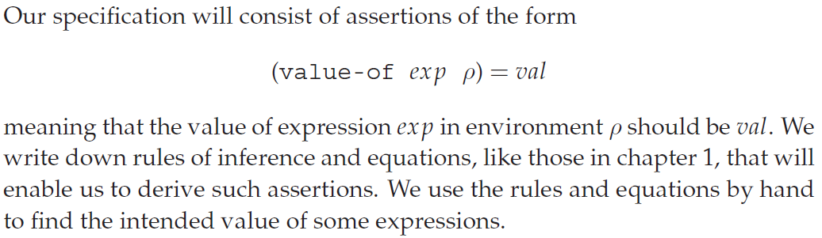
Specification and Implementation Strategy

Slide 4
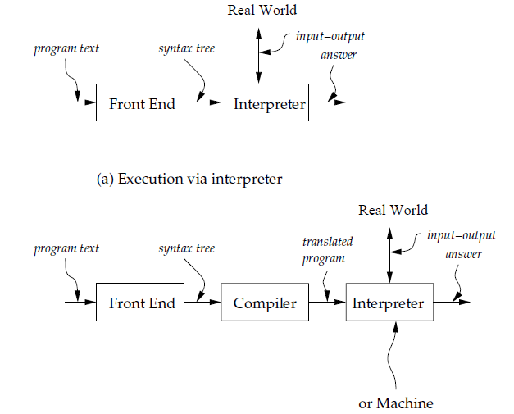

Slide 5
Language Processing System
We start with the text of the program written in the language we are implementing
This is called the source language or the defined language
Program text (a program in the source language) is passed through a front end
It converts the program to an abstract syntax tree
The interpreter is itself written in some language
We call that language the implementation language or the defining language
In figure 3.1(b), the interpreter is replaced by a compiler, which translates the abstract syntax tree into a program in some other language (the target language), and that program is executed

Slide 6
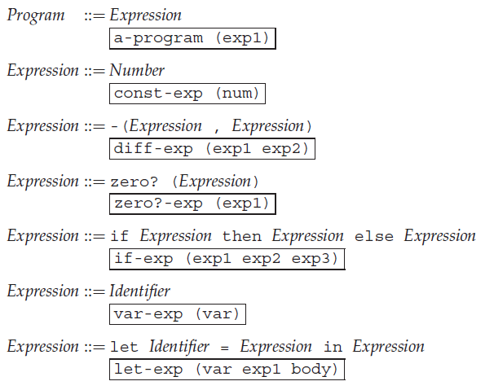
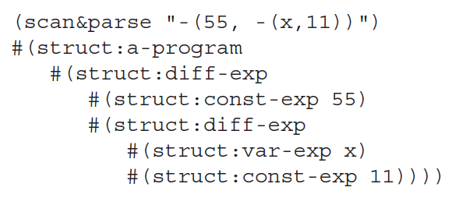
LET: A Simple Language

Slide 7
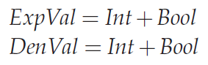
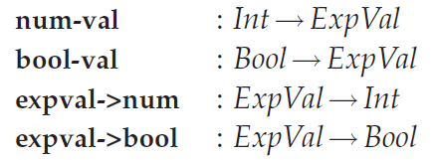
Specification of Values
An important part of the specification of any programming language is the set of values that the language manipulates
Each language has at least two such sets:
The expressed values
They are the possible values of expressions
The denoted values
They are the values bound to variables

Slide 8
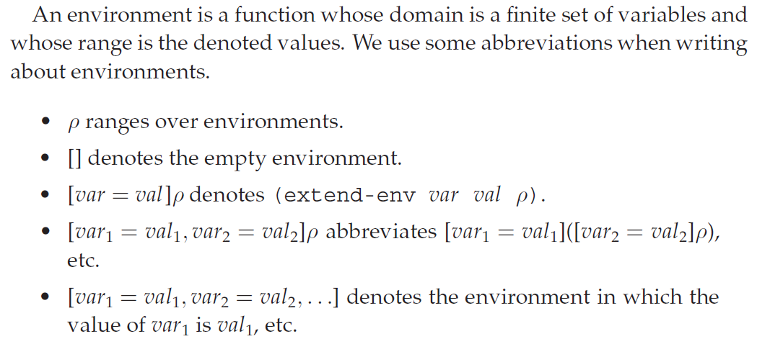
Environments

Slide 9
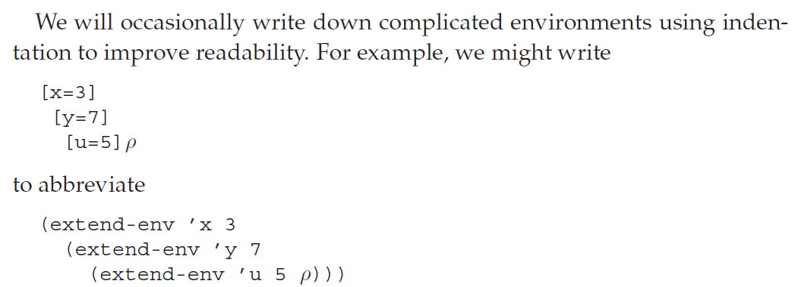
Environments

Slide 10
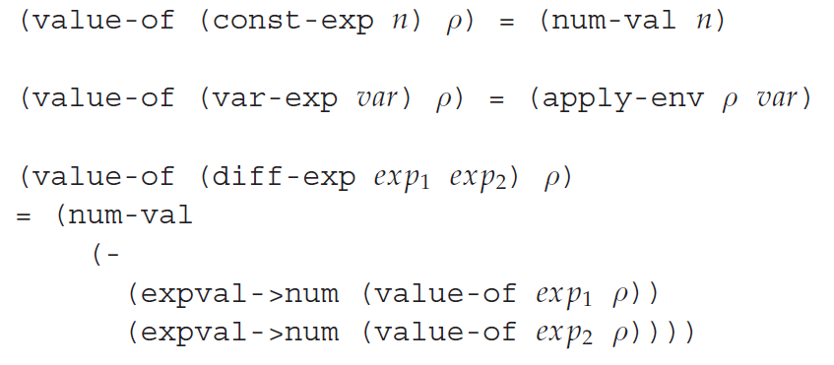
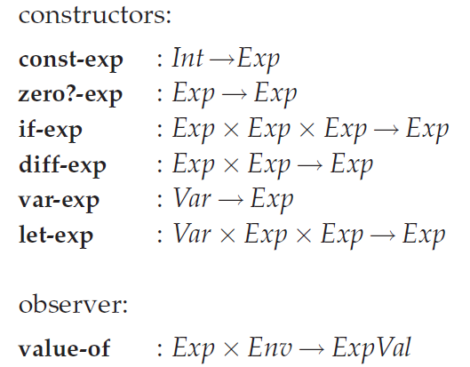
Specifying the Behavior of Expressions

Slide 11
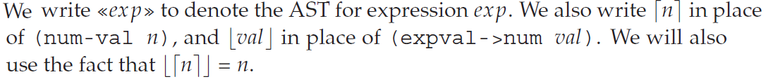
...

Slide 12
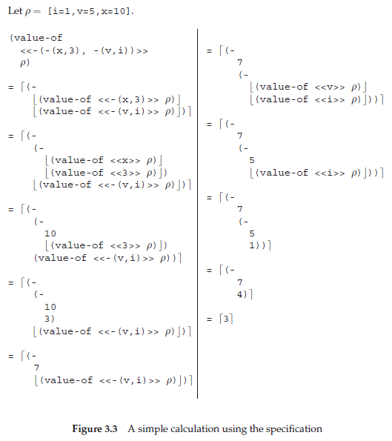

Slide 13
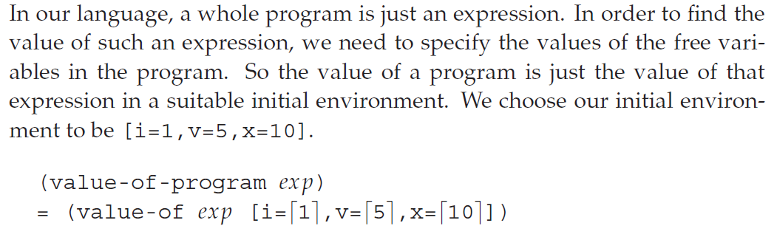
Specifying the Behavior of Programs

Slide 14
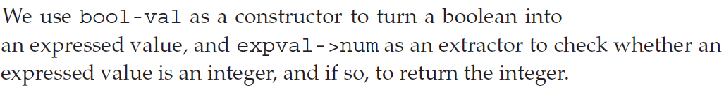
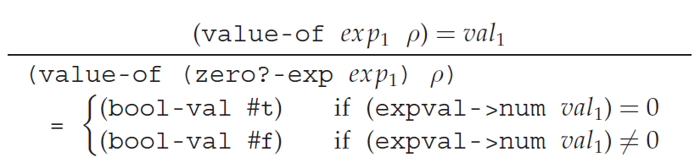
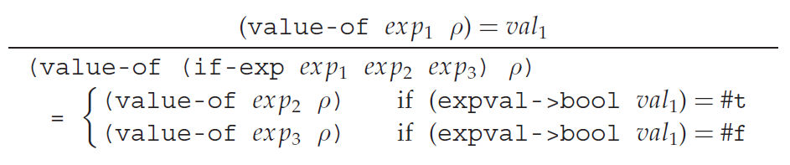
Specifying Conditionals

Slide 15
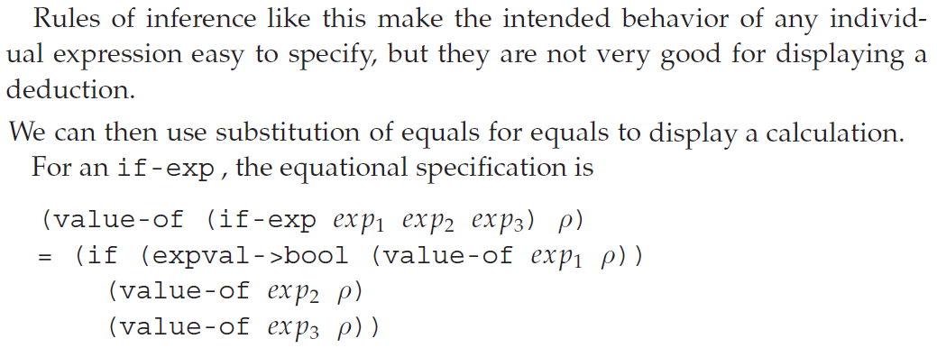
...

Slide 16
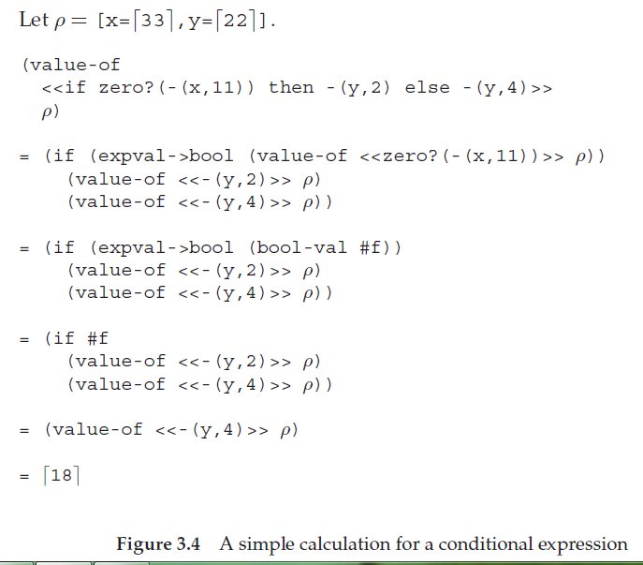

Slide 17
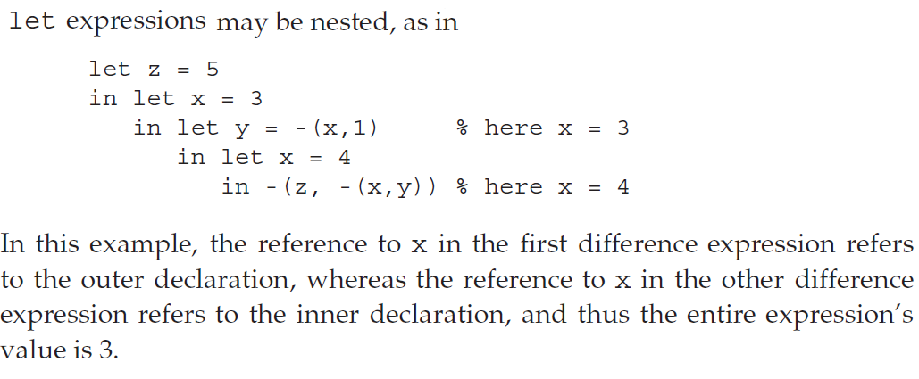
Specifying let

Slide 18
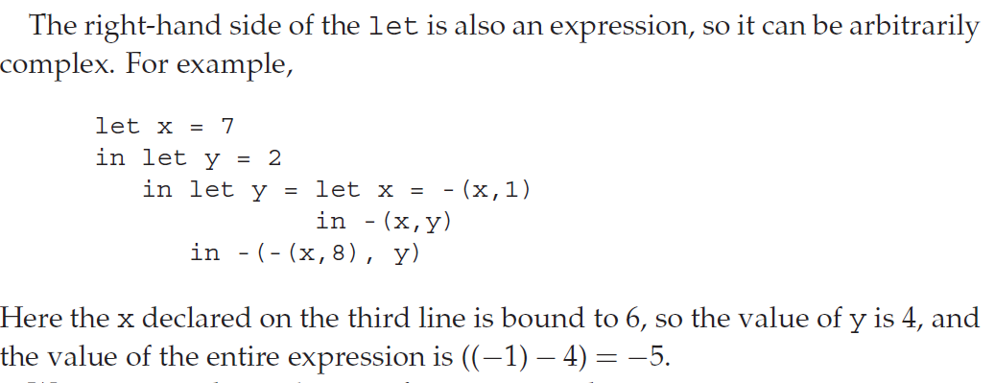
...

Slide 19
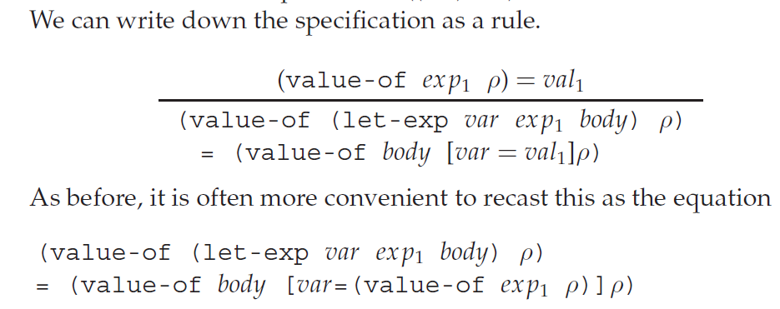
...

Slide 20
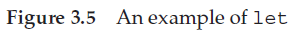
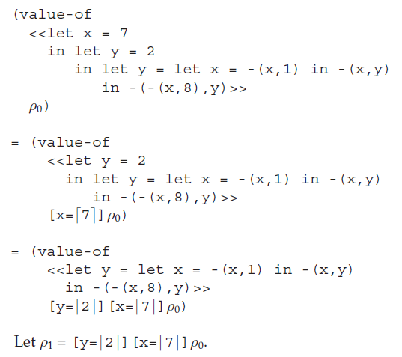

Slide 21
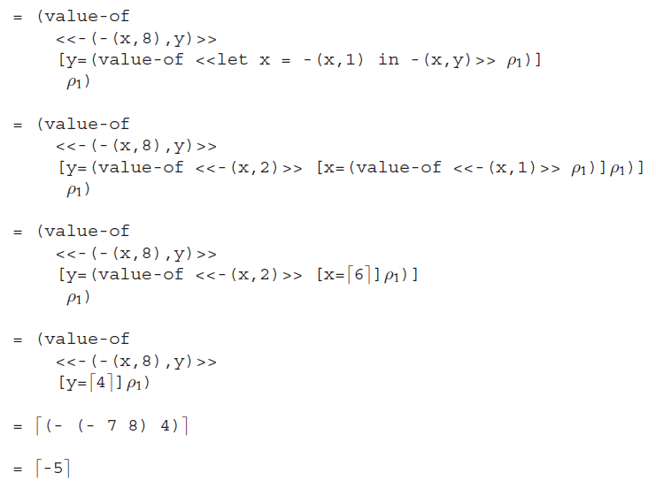

Slide 22
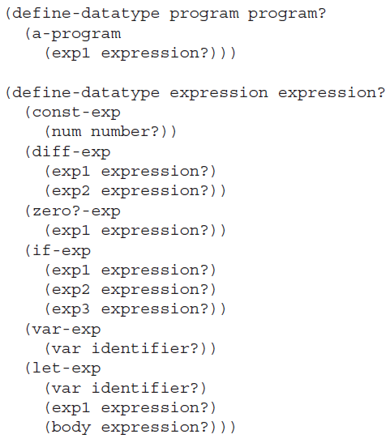

Slide 23
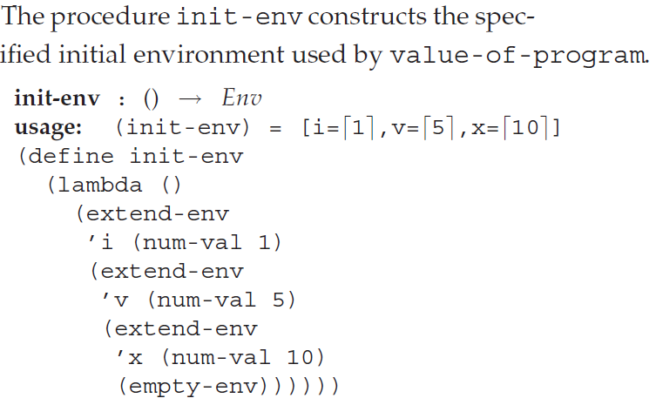
Implementing the Specification of LET

Slide 24
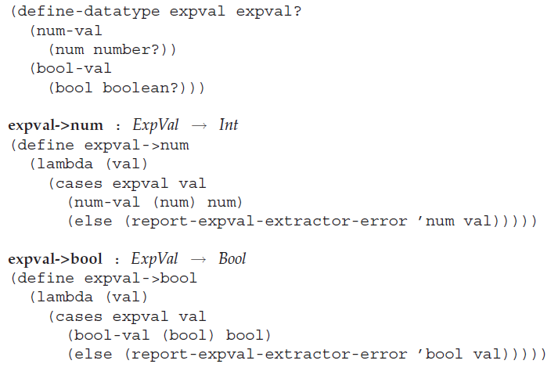

Slide 25
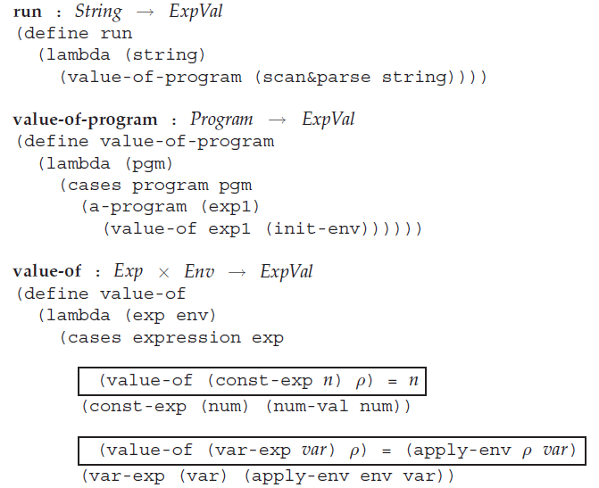

Slide 26
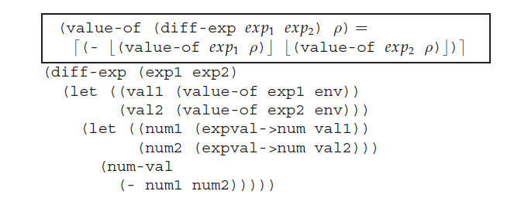
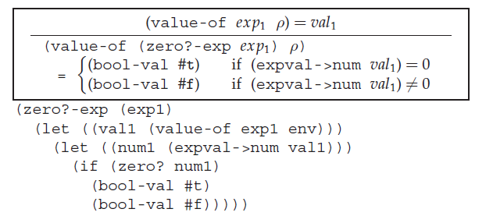

Slide 27
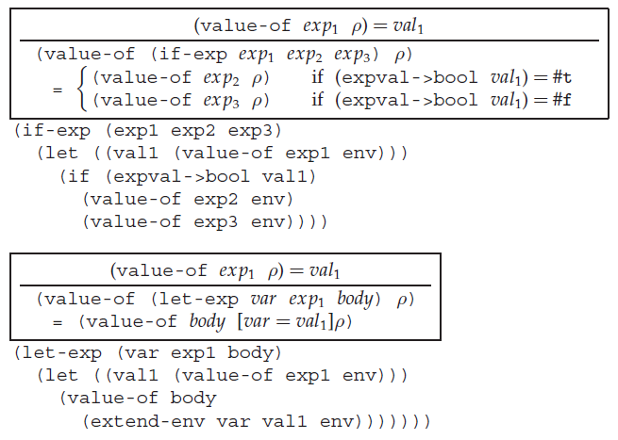

Slide 28
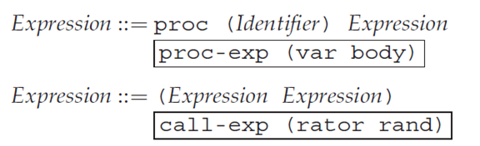
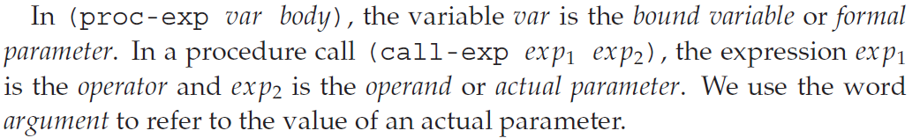
PROC: A Language with Procedures
We need syntax for procedure creation and calling. This is given by the productions:

Slide 29
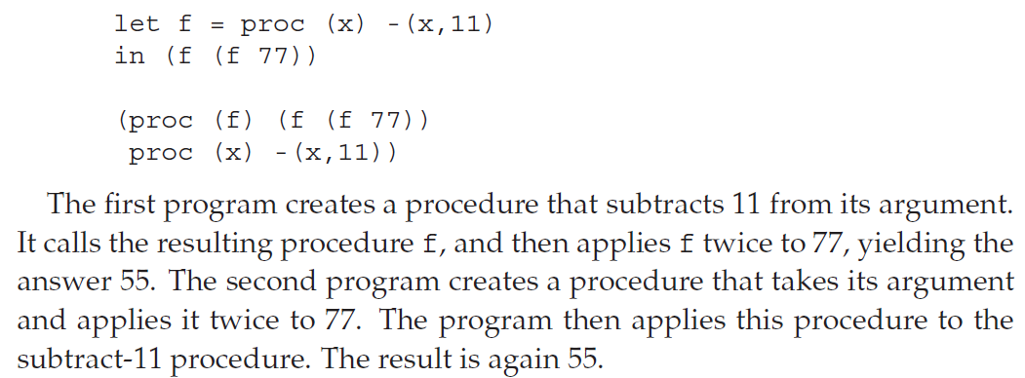
PROC: Example

Slide 30
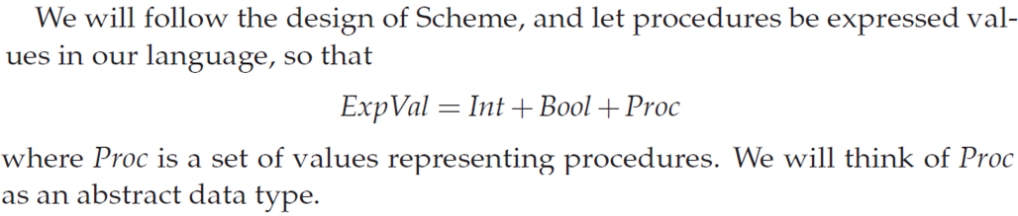
PROC

Slide 31
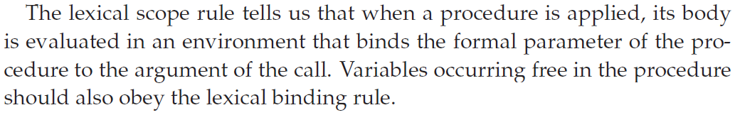
PROC

Slide 32
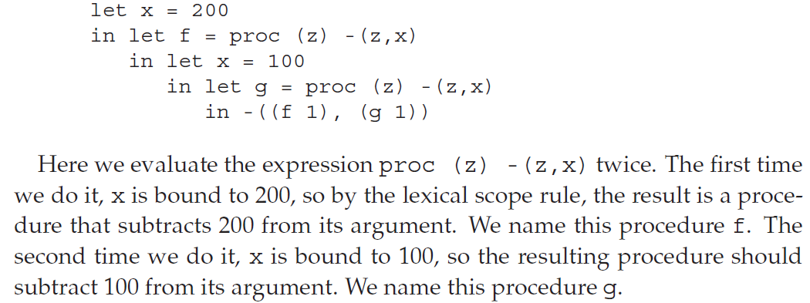
PROC: Example

Slide 33
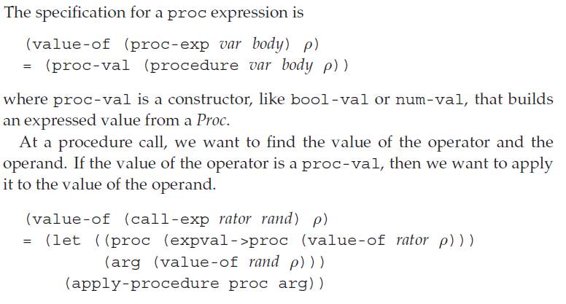
PROC: Specification

Slide 34
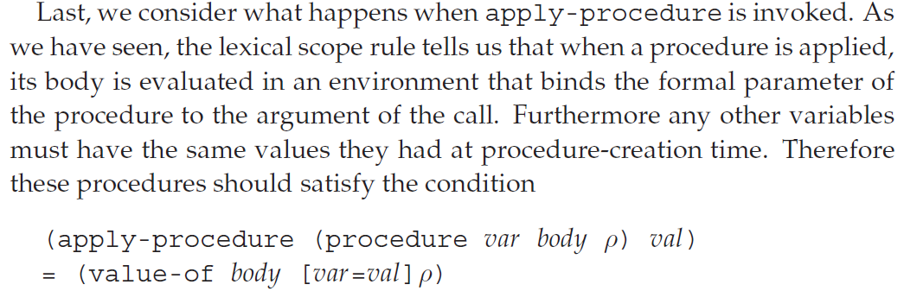
PROC: Specification

Slide 35
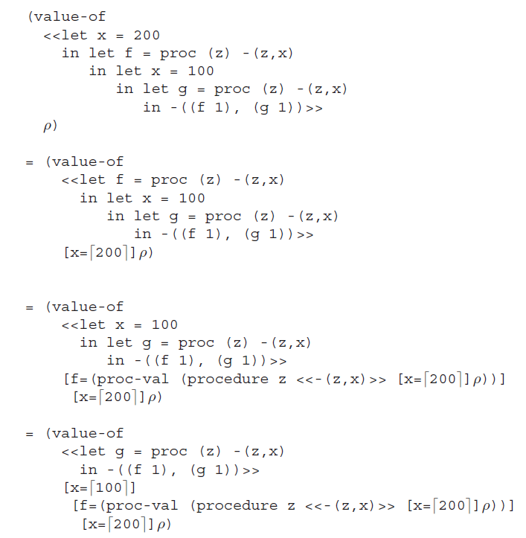
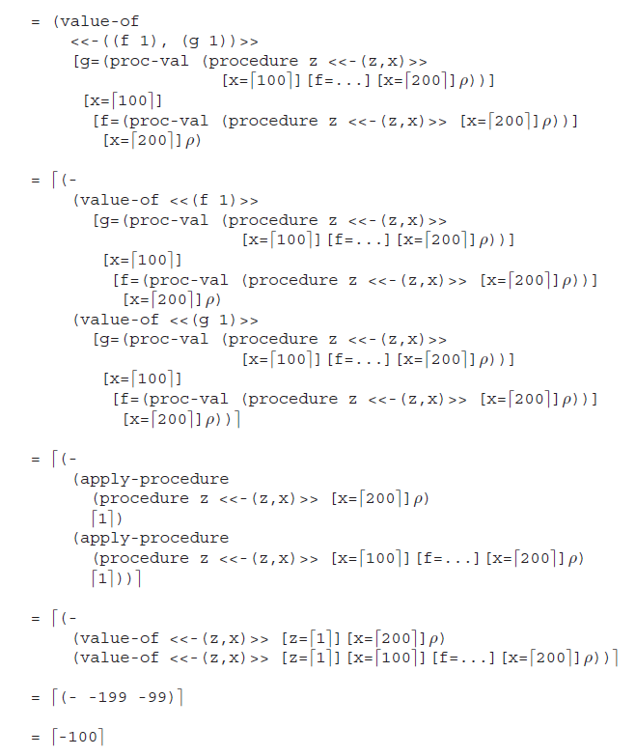

Slide 36
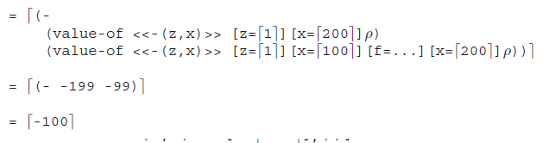

Slide 37
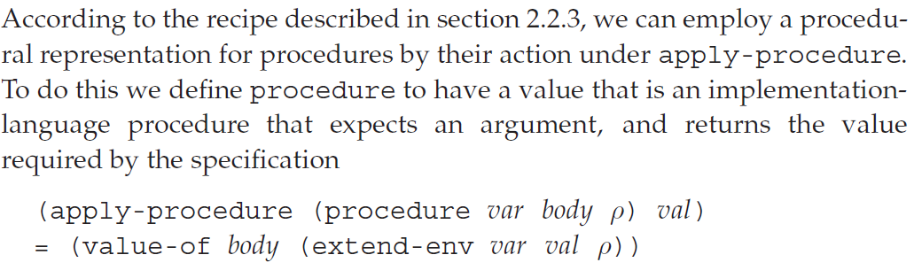
PROC: Procedural Representation

Slide 38
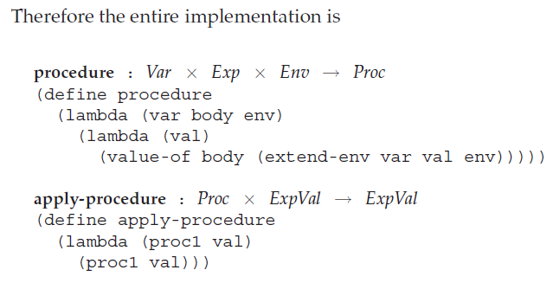
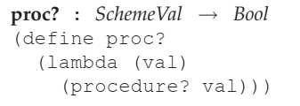
PROC: Procedural Representation

Slide 39
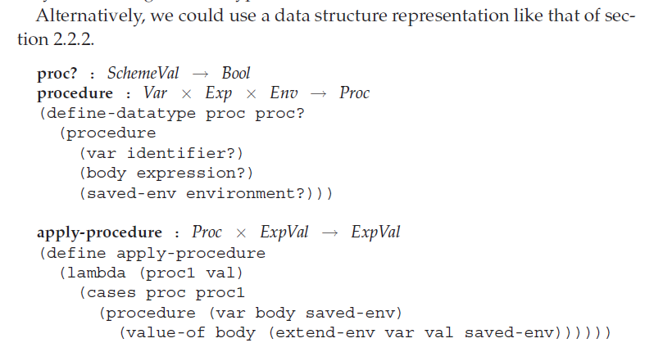
PROC: define-datatype

Slide 40
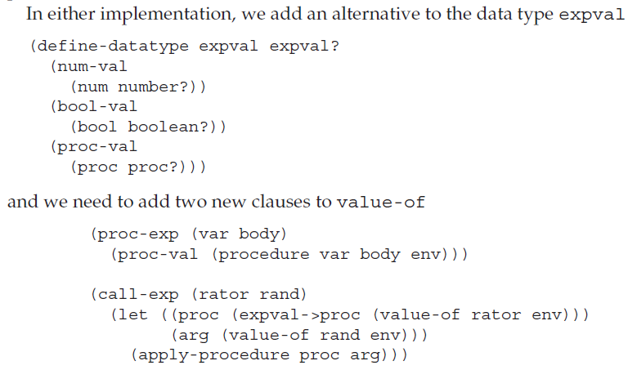
...

Slide 41
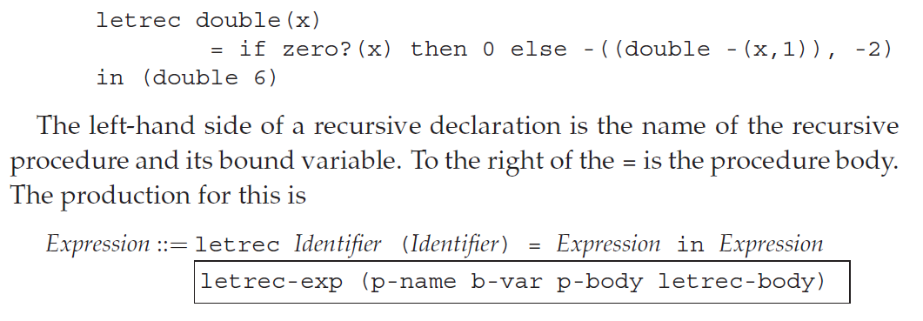
LETREC: A Language with Recursive Procedures
For example:

Slide 42
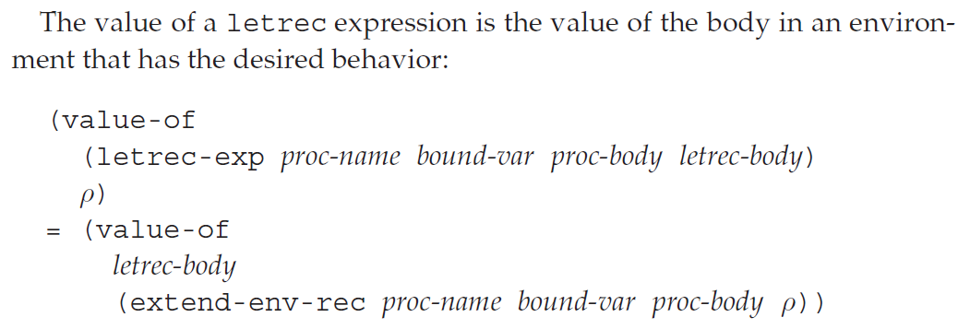
LETREC: Specification

Slide 43
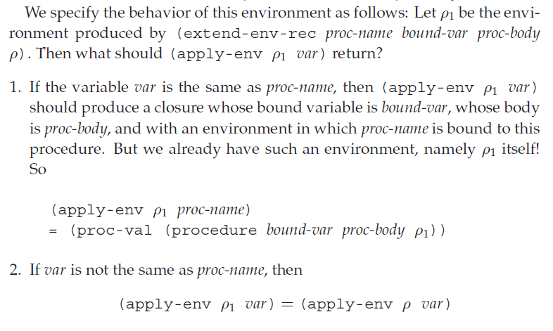
LETREC: Specification

Slide 44


Slide 45



Slide 46


Slide 47

Scoping

Slide 48

Scoping

Slide 49

...

Slide 50


Slide 51

Static properties

Slide 52

Contour diagram: Example
1

Slide 53

...

Slide 54

Binding

Slide 55

Extent of a binding

Slide 56

Eliminating Variable Names

Slide 57


Eliminating Variable Names

Slide 58

Lexical Addresses

Slide 59

Lexical Addresses

Slide 60


...

Slide 61

...

Slide 62

Implementing Lexical Addressing

Slide 63


...

Slide 64


The Translator

Slide 65

...

Slide 66


...

Slide 67


Slide 68

Writing The Translator

Slide 69

...

Slide 70



Slide 71

The Nameless Interpreter

Slide 72


The Nameless Interpreter

Slide 73



Slide 74



Slide 75

...

Slide 76


